Slide 1
EMAIL SPAM CLASSIFIER PROJECT
BY DEBANTI ROY

Slide 2
Business Problem Framing
Technology has become a vital part of life in today’s time. With each passing day, the use of internet increases exponentially, and with it the use of the email for the purpose of exchanging information and communicating has also increased. While e-mails are necessary for everyone, they also come with unnecessary, undesirable bulk mails, which are also called Spam Mails. Anyone with access to the internet can receive spam on their devices. Most spam emails divert people’s attention away from important emails and direct them towards detrimental situations. Spam emails are capable of filling up inboxes or storage capacities, deteriorating the speed of the internet to a great extent. These emails have the capability of corrupting one’s system by smuggling viruses into it, or steal useful information and scam gullible people. The identification of spam emails is a very tedious task and can get frustrating sometimes. While spam detection can be done manually, filtering out a large number of spam emails can take very long and waste a lot of time. Hence, the need for spam detection softwares has become the need of the hour. To solve this problem, various spam detection techniques are used now. The most common technique for spam detection is the utilization of Naive Bayesian method.

Slide 3
Conceptual Background of the Domain Problem
Spam email is unsolicited and unwanted junk email sent out in bulk to an indiscriminate recipient list. Typically, spam is sent for commercial purposes. It can be sent in massive volume by botnets, networks of infected computers.
Often, spam email is sent for commercial purposes. While some people view it as unethical, many businesses still use spam. The cost per email is incredibly low, and businesses can send out mass quantities consistently. Spam email can also be a malicious attempt to gain access to your computer.
Spam email can be dangerous. It can include malicious links that can infect your computer with malware (see What is malware?). Do not click links in spam. Dangerous spam emails often sound urgent, so you feel the need to act. Keep reading to learn about some of the basic spam types. Common types of spam are commercial advertisements, antivirus warnings, email spoofing, sweepstakes winners, money scams, etc. Gmail also automatically identifies spam and other suspicious emails and sends them to Spam.

Slide 4
Review of Literature
Comment: A comment is something that one says which expresses his/her opinion of something or which gives an explanation of it. In the online business market, comments are an essential way to assess the quality for a product/service that are posted by an existing user.
Spam: This can be defined as unsolicited usually commercial messages (such as emails, text messages, or Internet postings) sent to a large number of recipients or posted in a large number of places.

Slide 5
Motivation for the Problem Undertaken
A Spam Detector, as the name suggests, is used to detect unwanted, malicious and virus infected texts and helps to separate them from the nonspam texts. It uses a binary type of classification containing the labels such as ‘ham’ (nonspam) and spam. Application like this can be seen in Google Mail (GMAIL) where it segregates the spam emails in order to prevent them from getting into the user’s inbox.

Slide 6
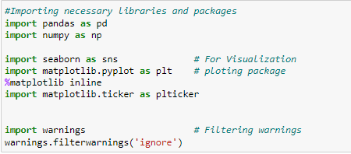

Importing the necessary libraries and packages

Slide 7
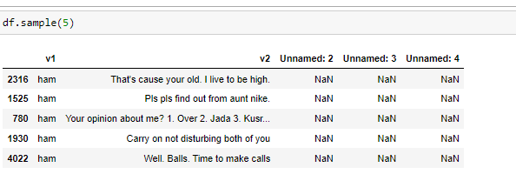
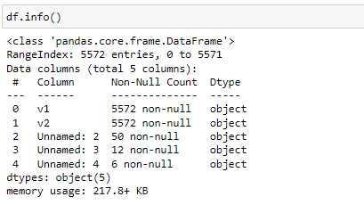
Exploratory Data Analysis(EDA)
A sample output of the dataset reveals 5 columns, where v1 indicates ‘spam’ or ‘ham’ referring to v2 which is the actual text or comments collected from various platforms. The last 3 columns are mostly NaN or Null values but we will find more about them in the following steps.
With ‘info()’ method we can see that the last 3 columns, viz., ‘Unnamed: 2’, ‘Unnamed:3’ and ‘Unnamed 4’ are mostly null with each having 50, 12 and 6 non-null values only. So, it seems that these fields are unimportant and can be dropped to clean data.

Slide 8

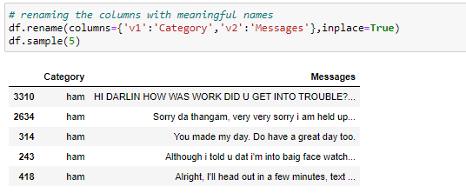
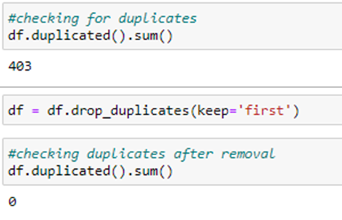
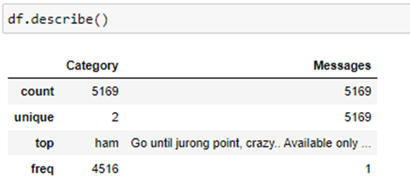
With ‘.drop()’ method we have deleted the unwanted columns.
We have renamed the important columns with more meaningful names.
Checked and removed all duplicate entries.
Used the “.describe()” method to get the statistical information of the cleaned data. We can see the cleaned data contains 5169 rows and most messages are 'ham' in nature counting to 4516.

Slide 9
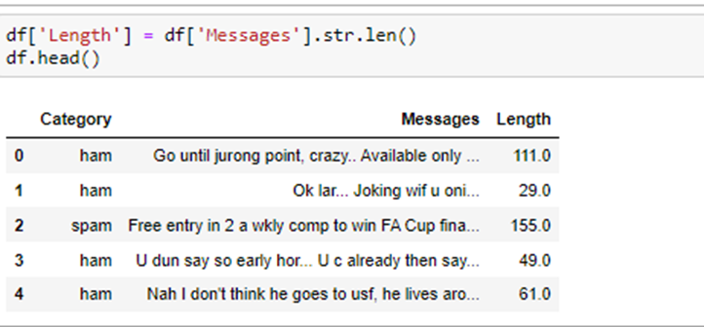
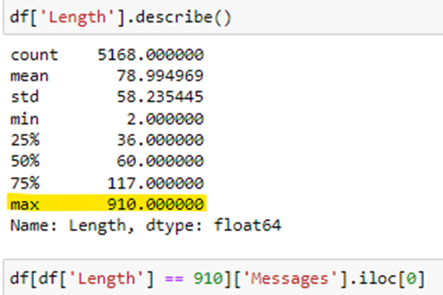
Checked the length of each text.
Found out the comment that has the maximum length.

Slide 10
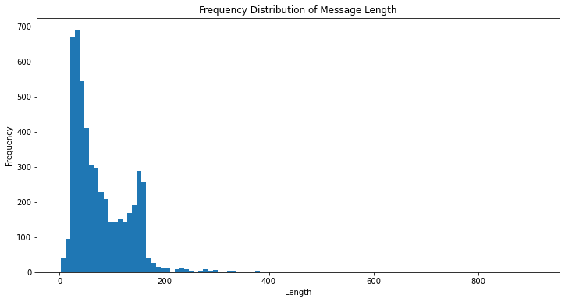
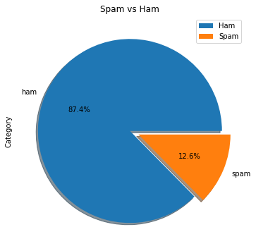
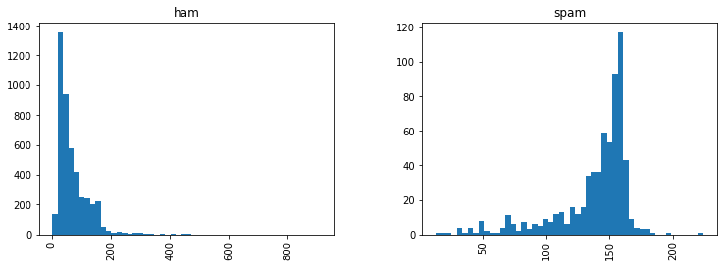
Data Visualization
We can see that 87.4% data is 'ham', that is marked in blue, while 12.6% data is 'spam', that is marked in orange.
Observation:
-The first one is a frequency distribution of the message length. Most of the message lenght is less than 200. Note that x-axis goes all the way to 1000ish, this must mean that there is some really long message!
-The second one is a frequency distribution in each category. Looks like spam messages are usually longer.

Slide 11
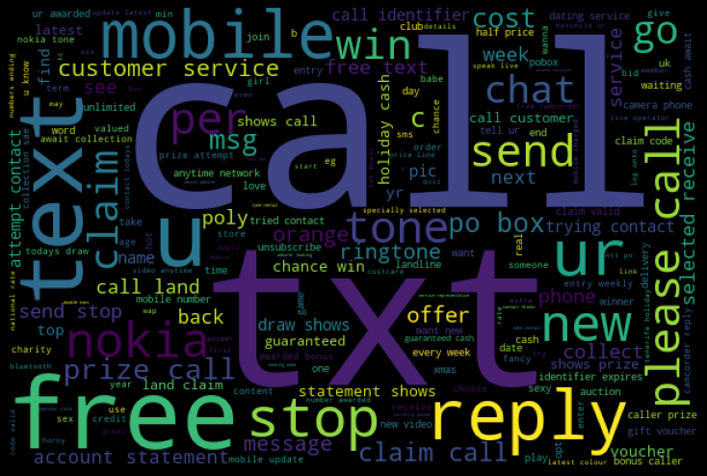
Wordcloud for spam messages shows that words like call, txt, win, free, reply, mobile, text etc. are widely used, let's check them statistically.

